Slide 1
MACHINE LEARNING
EXPERIENTIAL LEARNING
PHASE 1
CALORIES BURNT PREDICTION
BY-HARINIGOWDA(1RV20MC024)
MARCELO.D(1RV20MC046)

Slide 2
PROBLEM DEFINITION
When person excersises there is loss of calories which can be based on n factors.
It depends on the body type of the person is doing,the food consumed by the person before the workout,intensity of the workout ,cardiovascular excersise,weight training,HIIT(High Intensity interval training) and metabolism of the individual can also be accounted for.The food consumed by the individual before the workout.The food consumed might be rich in carbohydrates and which need to be further broken down into its molecular elements like fructose or glucose which when the person excersises breaks down to give energy with the help of oxygen present in the blood,the muscle impacted during the excersise of the target muscles requires this oxygen,to meet this requirement the heart beat increases a lot,which facilitates increased blood flow,that will help in supplying more oxygen to the muscle,which is used to break the glucose molecules.

Slide 3
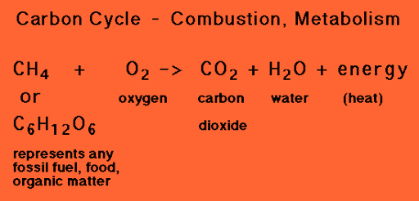
We can infer that, when a person does excersise the heart beat is more.Normal blood pressure is 75Bpm but when excersising the heart beat may increase upto 100Bpm, and when this energy is used to do excersise only some part of it used the rest of it is converted into heat,the body temperature increases ,to reduce this temperature the body will release sweat,which helps in cooling down the body temperature.The below equation represents the same.

Slide 4
DATASET AND FEATURES
THE PARAMETERS CONSIDERED ARE:
Duration of excersise performed by the person.
Body temperature of that person.
Average heart beat per minute when doing the excersise.
Height of the person.
Weight of the person.

Slide 5
DATASET AND FEATURES
Two datasets used are:
1.excersise.csv(comma seperated values)
2.calories.csv
(https://www.kaggle.com/fmendes/fmendesdat263xdemos?select=exercise.csv)

Slide 6
excersise.csv
This dataset consists of:
User_ID-Unique ID for each individual person.
Gender-Male or female.
Duration-Duration of the excersise they are doing.
Heart_Rate-Average Heart rate.
Body_Temp(in C)-After excersise,hence the temperature may be more than the normal body temperature.

Slide 7
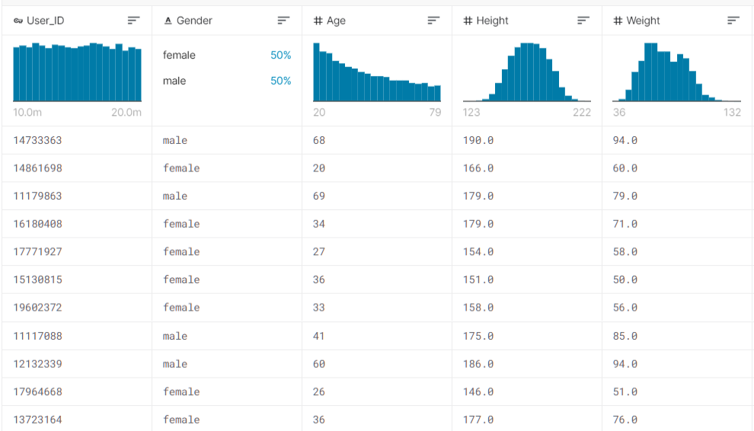
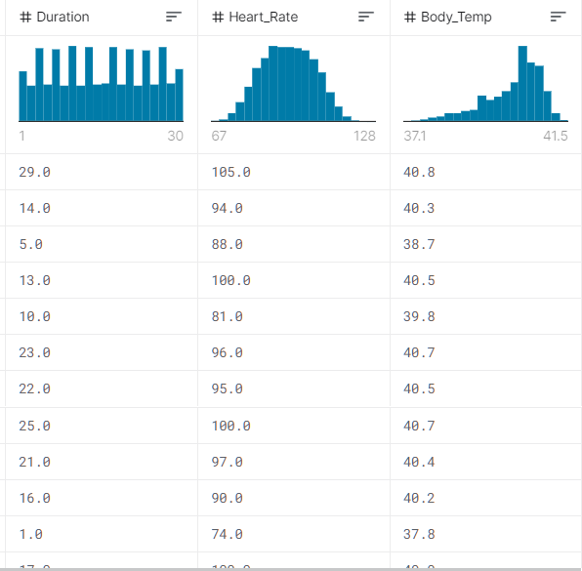
excersise.csv

Slide 8
calories.csv
This dataset consists of:
User_ID-Same ID as in excersise.csv.
Calories-calories burnt by the individual.
We combime both the datasets.

Slide 9
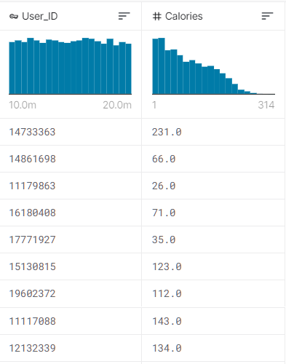
calories.csv

Slide 10
ML ALGORITHM USED
Here we use decision tree alogorithm using XGBoost library.Specifically gradient boosting decision tree algorithm is used.
It is used as-
large number of observations in training data.
Number features < number of observations in training data.
It performs well when data has mixture numerical and categorical features or just numeric features.
When the model performance metrics are to be considered.
This algorithm is used as it gives highly accurate predictions.
This algorithm is preffered over random forest.

Slide 11
THANK YOU

